Slide 1
Edge-based Evolved Packet Core (EPC) Refactoring for High Speed Mobility
Wei-Kuo Chiang and Ming-Wei Wang

Slide 2
Outline
Introduction and Motivation
Related Works
Edge-based Refactoring EPC
Conclusion

Slide 3
LTE/EPC Architecture Issues
The Evolved Packet Core (EPC) in LTE adopts a centralized architecture.
User-plane traffic and control-plane signaling both converge at the core network.
This causes high latency, control-plane bottlenecks, and session interruptions under high mobility.

Slide 4
Motivation & Problem
For fast-moving users, frequent handovers amplify these issues.
Long data paths through centralized gateways increase end-to-end delay.
Session continuity breaks when switching across edge boundaries.
Notes:
如果control entities佈署於eNB，代表服務的用戶只要移動並更換服務的eNB，就需要重新與這些control entities進行註冊，這會面臨龐大的signaling cost與用戶重新註冊的時間花費。

Slide 5
Main Contributions
The design is based on 3GPP Release 14 CUPS (Control and User Plane Separation),enabling simpler and more flexible deployment of gateway components.
Refactoring Approach:
  Identify functional sequences of EPC components in all LTE procedures.
  Represent them as function strings to analyze possible combinations.
  Evaluate merging combinations using three indicators

Slide 6
Main Contributions
MME + S/PGW-C → split into
  ARM (Authentication & Registration Mobility) – manages registration & location update
  SMC (Session Management Control) – manages session procedures
By deploying SMC and Gateway at the Edge and ARM in the Core,E-R-EPC achieves low-latency local during user mobility.

Slide 7
Main Contributions
Inter-Edge Handover Design
  Introduced inter-edge handover to ensure session continuity when UE moves between edge networks.
  Pre-allocated IP and tunneling mechanism maintain uninterrupted sessions.

Slide 8
Outline
Introduction and Motivation
Related Works
Edge-based Refactoring EPC
Conclusion

Slide 9
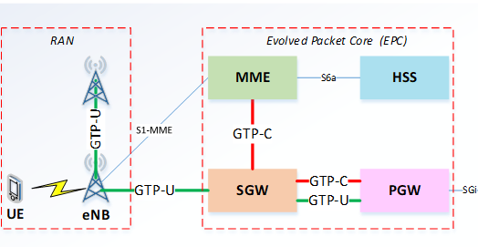
LTE Network Architecture
HSS (Home Subscriber Server)Stores user subscription data.Handles authentication and access authorization.
MME (Mobility Management Entity)Manages control signaling for user registration and session setup.Handles handover procedures between eNBs.
SGW (Serving Gateway)Routes and forwards user-plane traffic.Acts as Mobility Anchor during handover.
PGW (Packet Data Network Gateway)Serves as Session Anchor to external networks.Performs policy control, packet filtering, charging, and IP address allocation.
Notes:
SGW (Serving Gateway)負責繞送data traffic，它也作為handover的Mobility Anchor。
PGW (Packet Data Network Gateway)負責作為Session Anchor，將packets送至external network，它還執行了功能像是policy enforcement, packet filtering, charging and IP address allocation。

Slide 10
Tracking Area
MME records the UE’s registered location using Tracking Area (TA).
When a UE moves into a new TA, a Tracking Area Update (TAU) procedure is triggered to update its location in the MME.
To avoid frequent TAU procedures during UE movement, a TA List mechanism is used. During UE registration, the MME allocates a TA List containing several TAs.
Notes:
MME利用Tracking area (TA)來記錄用戶的註冊位置，一個TA包含了許多eNBs 範圍的cells，若是UE進入新的TA範圍就必須要進行Tracking area update (TAU)的流程以更新MME記錄的資訊，為了避免頻繁地TAU，所以有了TA list的機制，當中包含了許多TAs，當UE在剛開始註冊時，MME會分配TA list給UE，只要UE在TA list的範圍底下都不需要做TAU更新位置。

Slide 11
Location Update
If the UE moves to a TA managed by a new MME:
The new MME retrieves the UE context from the old MME.
Then, it notifies the HSS to update the UE’s current MME information.
The HSS cancels the UE context stored in the old MME after updating.
Notes:
在UE進入新的TA，而且沒有UE context儲存在連線的新MME底下的情況，新的MME便會依據UE的註冊資訊找到Old MME，並且得到UE context，再去向HSS更新該UE紀錄的MME位置，之後HSS會去cancel Old MME紀錄的UE context。

Slide 12
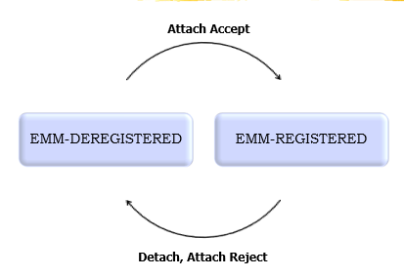
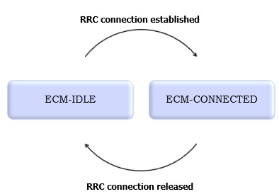
Basic Procedures in LTE/EPC
Initial Attach
Active to Idle (S1 Release)
Service Request (UE triggered),
Service Request (Network triggered)
Tracking area update (TAU)
X2-based handover
S1-based handover

Slide 13
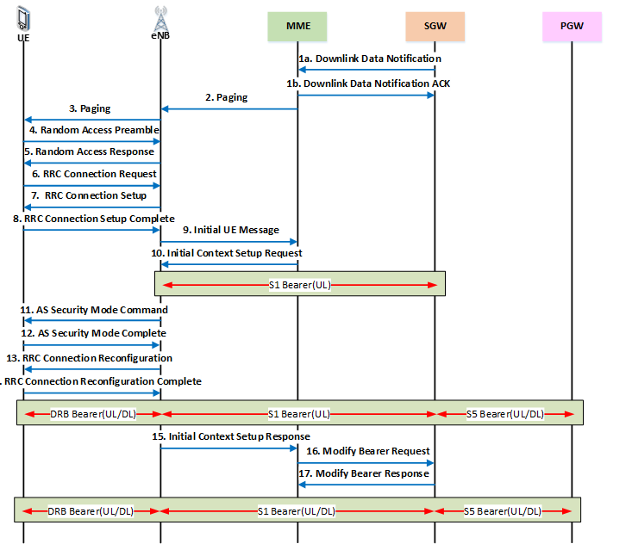
Idle to Active (Network triggered)
Notes:
這個訊息交換流程發生在當網路方有downlink traffic傳送給Idle狀態的UE時，此時gateway沒有bearer傳送到UE，會去詢問MME，MME會根據UE註冊的TA位置去做Paging，找到UE後，便會開始重新建立bearer連線的流程以接收traffic。
(7) MME向eNB發送Initial Context Setup Request，以建立S1 bearer (eNB between SGW)
(8)-(11) UE與eNB建立AS security流程，結束後UE與eNB間的DRB即建立完成
(12) eNB傳送Initial Context Setup Response給MME，以回應step(7)，當中包含eNB分配的downlink S1 bearer的TEID
(13)-(14) MME傳送Modify Bearer Request給SGW，訊息中會帶downlink S1 bearer TEID以建立downlink S1 bearer

Slide 14
Bearer
Bearer
Dedicated Bearer
Non-GBR
GBR
Default Bearer
(permanently established)
Non-GBR
EPS Bearer
Radio Bearer
S1 Bearer
S5/S8 Bearer
GBR : Guaranteed bit rate
Notes:
所謂GBR，是指bearer要求的bit rate被網絡“永久”恆定的分配，即使在網絡資源緊張的情況下， bit rate也能夠保持。
Non-GBR指的是在網絡擁擠的情況下，bearer需要承受降低速率的要求，由於Non-GBR bearer不需要佔用固定的網絡資源，因而可以長時間地建立。而GBR bearer一般只是在需要時才建立。
EPS系統中，為了提高用戶體驗，​​真正實現用戶的always-on，引入了Default Bearer的概念，即在用戶開機，進行attach的同時，為該用戶建立一個固定數據速率的Default Bearer，保證其基本的業務需求，Default Bearer是一種Non-GBR承載。
Upon UE is assigned an IP address by the P-GW , at least one bearer is established.
This is called the default bearer, and it remains established throughout the lifetime of connection to provide the UE with always-on IP connectivity.

Slide 15
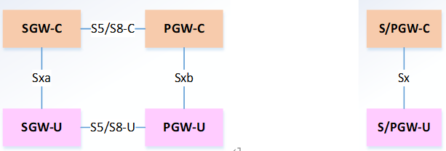
Control and User Plane Separation (CUPS)
According to 3GPP TS 23.214 , the EPC introduces Control and User Plane Separation (CUPS) for gateways.
This design simplifies gateway functions and enhances deployment flexibility.
components separated from the gateway
CUPS with gateway-merged

Slide 16
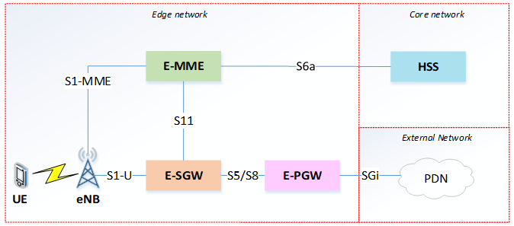
Full-edge EPC
This design, called Full-edge EPC, allows:
  Most procedures to be handled entirely within the edge.
  UEs to directly access external networks through the edge.
  Significant reduction in transmission latency compared to legacy EPC.
These inter-edge communications between edge and core networks cause high signaling and transmission costs.
Notes:
缺點為在edge networks間移動的話，因為離開E-MME的管理範圍，所以需要進行更換E-MME並向HSS更新的程序，此步驟需要在edge network與core network來回溝通完成，將造成龐大的傳輸成本。

Slide 17
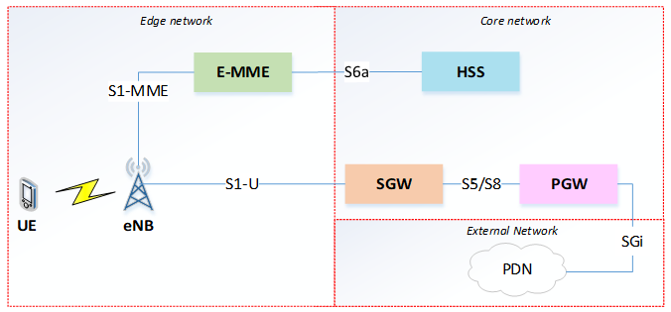
Partial-edge EPC
Advantages
          During handover, the gateways remain in the core, so there is no need to reconfigure gateways,reducing control signaling cost compared with Full-edge EPC.
Limitations
When a UE moves between edge networks, it leaves the E-MME management scope;
an E-MME change and HSS update are required,leading to high transmission cost between edge and core networks.
All User-plane traffic must still pass through the core network to reach external networks
Notes:
因為gateway佈署於core network，所以在流程中不需要做gateway的替換，減少需要重新配置的控制訊號成本，然而，他們沒有考慮到下列缺點: (1) 所有的User plane traffic都需要經由core network才能連接到外部網路，產生較長的傳輸距離以及傳輸延遲問題，(2) 這個問題和Full-edge EPC一樣。在edge networks間移動的話，因為離開E-MME的管理範圍，所以需要進行更換E-MME並向HSS更新的程序，此步驟需要在edge network與core network來回溝通完成，將造成龐大的傳輸成本。

Slide 18
Features of two architectures
 | Full-edge EPC | Partial-edge EPC
User plane routing path | Short | Long
Data traffic transmission latency | Low | High
Support handover between two edge networks | N/A | Yes
The change of MME when UE moving between two edge networks | Need | Need
Notes:
Partial-edge EPC可以基於Mobility Anchor在core network的設計提供換手的服務。
而Full-edge EPC的設計將PGW佈署於edge network，這需要觸發inter-PGW handover，會面臨UE IP更換的挑戰，這部分作者並沒有說明做法。

Slide 19
Outline
Introduction and Motivation
Related Works
Edge-based Refactoring EPC
Conclusion

Slide 20
Refactoring EPC Control Plane Functions
Focus on Control Plane components
Based on CUPS EPC architecture
Group functions by sequence continuity and expected benefits
Decompose only MME functions (interfaces M1–M8)
Component | Function
MME | M1: GUTI handling
 | M2: MME S1AP ID handling
 | M3: NAS Security, User authentication
 | M4: Location value handling
 | M5: UE Reachability in IDLE state
 | M6: EPS bearer management
 | M7: TA List / TAU Timer Value handling
 | M8: handover messages handling (include context transfer)

Slide 21
Function Sequence Mapping in Basic Procedures
Simplified notation: E = eNB, H = HSS, C = S/PGW-C, U = S/PGW-U.
Consecutive MME (or MME+PGW-C) function pairs are identified as merge candidates (highlighted in yellow).
Procedure | Corresponding String for the Sequence of Functions
IA | UE, E, UE, E, UE, M2, M3, H, M3, UE, M3, UE, M3, M4, H, M6, C, U, C, M6, M1, M7, E, UE, E, UE, E, UE, M6, C, U, C, M6
AtI | E, M6, C, U, C, M6, E, UE, E
ItA (UE) | UE, E, UE, E, UE, M2, M6, E, UE, E, UE, E, M6, C, U, C, M6
ItA (Net) | U, C, M5, E, UE, E, UE, E, UE, M2, M6, E, UE, E, UE, E, M6, C, U, C, M6
X2 | UE, E, UE, E, M8, M6, C, U, C, M6, M8, E
S1 | UE, E, M8, E, M6, C, U, C, M6, M8, E, UE, E, M6, C, U, C, M6, E, M6, C, U, C, M6
TAU | UE, E, UE, E, UE, M2, M6, C, U, C, M6, M4, M7, UE

Slide 22
Indicators for Evaluating Merged EPC Functions
MER (Message Exchange Reduction): Reduction in the number of message exchanges achieved by merging adjacent EPC functions.
MHN (Message Handling Number): Total number of messages that the merged component must handle.
SSE (Scaling Side Effect): Count of unnecessary functions that are triggered when scaling the merged component.

Slide 23
MER, MHN, and SSE Example Analysis
AtI sequence (Initial Attach): [E, M6, C, U, C, M6, E, UE, E]
Merge [M6] + C:
  MER = 2 (two exchanges eliminated)
  MHN = 2 (two messages now handled internally)
Merge [M2] + M6: SSE = 1 (one function, M2, becomes unnecessary in this sequence)

Slide 24
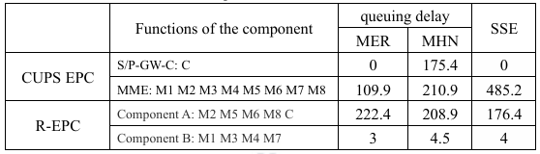
Refactoring EPC Architecture (R-EPC)
Function pairs with relatively lower rate values (MHN / MER)
It can be observed that the functions of (M6, C), (M2, M6), (M8, M6), and (C, M5) are overlapping, while (M4, M7), (M1, M7), and (M3, M4) also share overlaps.
Merged function | queuing delay |  | SSE | Rate (MHN/MER)
 | MER | MHN
M6, C | 157.2 | 206.2 | 0 | 1.31
M2, M6 | 36 | 193.7 | 42.2 | 5.38
M8, M6 | 16.2 | 191.4 | 70.5 | 11.8
C, M5 | 15 | 174.2 | 63.7 | 11.6
M4, M6 | 2 | 191.7 | 76.2 | 95.85
M4, M7 | 2 | 3 | 0 | 1.5
M6, M1 | 0.5 | 191.2 | 78.2 | 382.4
M1, M7 | 0.5 | 2.5 | 2 | 5
M3, M4 | 0.5 | 4 | 2 | 8
M2, M3 | 0.5 | 37.5 | 36 | 75

Slide 25
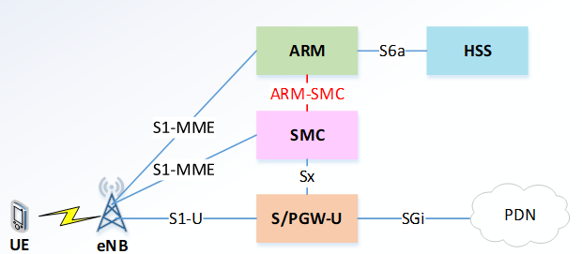
Refactoring EPC Architecture (R-EPC)
Component grouping:
  Component A → ARM (Authentication & Registration Mobility component)
  Component B → SMC (Session Management Control component)
  → ARM handles registration and authentication, while SMC handles session management.
Other components such as HSS, S/PGW-U, and eNB remain unchanged.

Slide 26
Interface Evolution
The original S1-MME interface between eNB and MME is divided into two connections:
  eNB ↔ ARM
  eNB ↔ SMC
A new interface, ARM–SMC, is established to enable coordination between ARM and SMC.
This evolution enhances modularity and flexibility in R-EPC communication flow.

Slide 27
Component Deployment Discussion
The proposed Edge-based Refactored EPC (E-R-EPC) aims to maximize architectural efficiency.
User-plane gateway (S/PGW-U) is deployed at the edge, called E-S/PGW-U, to:
  Reduce network congestion and transmission delay.
  Provide local PDN connectivity for UEs.
SMC is also deployed at the edge to reduce propagation delay with eNB and E-S/PGW-U.
ARM deployment options:
  ARM at Core: avoids frequent MME switching between edges.
  ARM at Edge: shortens signaling path with SMC for lower delay.

Slide 28
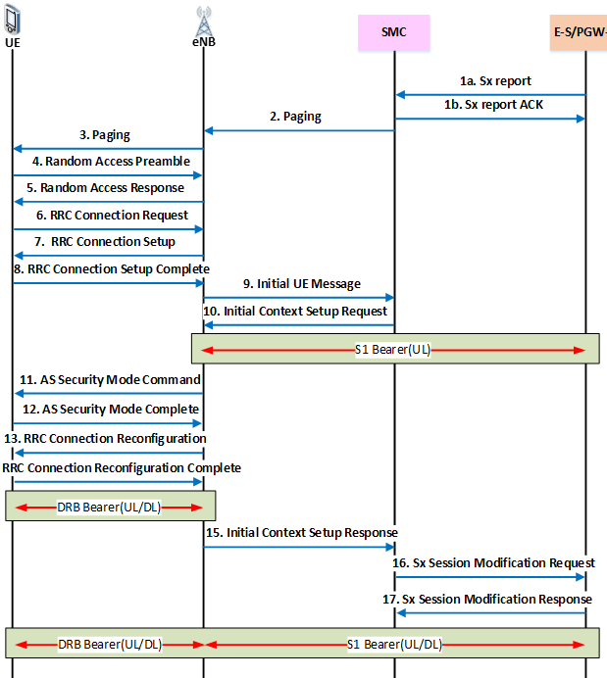
Idle to Active (Network triggered) in E-R-EPC

Slide 29
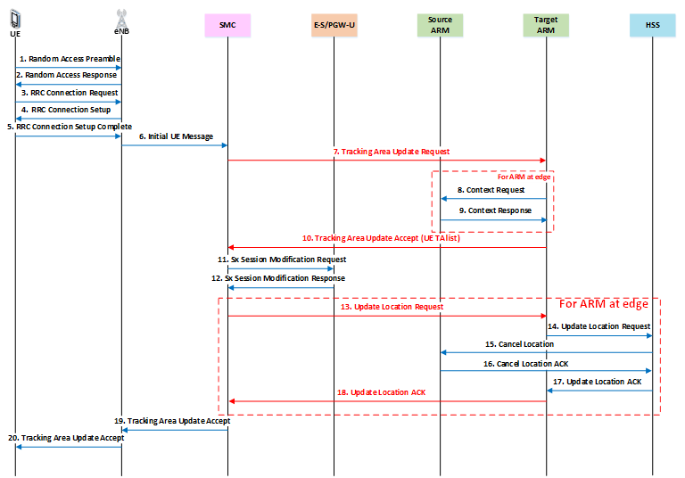
Tracking area update in E-R-EPC

Slide 30
Inter-Edge Handover Procedure of E-R-EPC
Since E-R-EPC includes two sub-architectures — ARM at Edge and ARM at Core — the procedures differ.
An interface called SMC–SMC is designed to handle Session Management message transmission between edge networks.
ARM at Core:
  Source and Target eNBs connect to different SMC and E-S/PGW-U,but share the same ARM and are within the same TA.
ARM at Edge:
  Source and Target eNBs connect to different SMC, ARM, and E-S/PGW-U,but share the same HSS.
  The change of ARM requires HSS update to record the UE’s new ARM location.

Slide 31
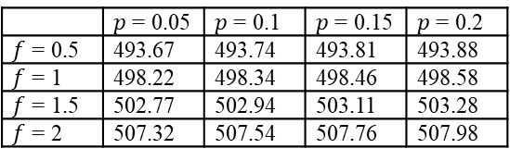
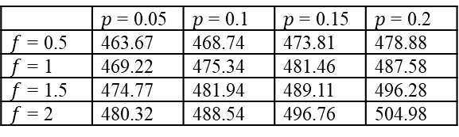
Component Deployment Discussion
We use the number of message exchanges on each transmission path as an indicator of bandwidth consumption.
hopS​=1, ℎ𝑜𝑝𝐴=8
𝐹 𝑝𝑟𝑜𝑐𝑒𝑑𝑢𝑟𝑒 ​: frequency of the procedure
𝑃 𝑝𝑟𝑜𝑐𝑒𝑑𝑢𝑟𝑒 ​: edge-switching probability
S: Same-area communication (edge or core)
A: Across-area communication (edge ↔ core)
 | $p$ = 0.05 | $p$ = 0.1 | $p$ = 0.15 | $p$ = 0.2
$f$ = 0.5 | 463.67 | 468.74 | 473.81 | 478.88
$f$ = 1 | 469.22 | 475.34 | 481.46 | 487.58
$f$ = 1.5 | 474.77 | 481.94 | 489.11 | 496.28
$f$ = 2 | 480.32 | 488.54 | 496.76 | 504.98
 | $p$ = 0.05 | $p$ = 0.1 | $p$ = 0.15 | $p$ = 0.2
$f$ = 0.5 | 493.67 | 493.74 | 493.81 | 493.88
$f$ = 1 | 498.22 | 498.34 | 498.46 | 498.58
$f$ = 1.5 | 502.77 | 502.94 | 503.11 | 503.28
$f$ = 2 | 507.32 | 507.54 | 507.76 | 507.98
Bandwidth cost of E-R-EPC (ARM at edge)
Bandwidth cost of E-R-EPC (ARM at core)
Notes:
Parameter Settings:
Probability of inter-edge switching
Movement frequency between edges

Slide 32
Component Deployment Discussion
Conclusion: ARM at edge saves bandwidth under low mobility, but efficiency advantage decreases under high inter-edge mobility.
Architecture | Observation
ARM at Edge | Lower bandwidth cost overall
ARM at Core | Slightly higher cost, but difference decreases as p and f increase

Slide 33
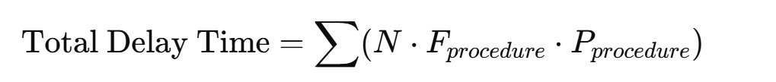
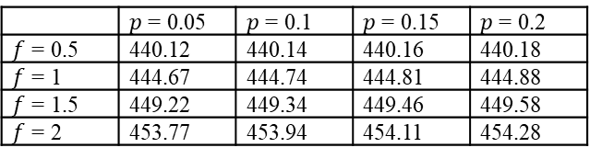
Transmission Delay & Handover Variability Analysis
N = message exchanges
Same F and P as before
 | $p$ = 0.05 | $p$ = 0.1 | $p$ = 0.15 | $p$ = 0.2
$f$ = 0.5 | 440.12 | 440.14 | 440.16 | 440.18
$f$ = 1 | 444.67 | 444.74 | 444.81 | 444.88
$f$ = 1.5 | 449.22 | 449.34 | 449.46 | 449.58
$f$ = 2 | 453.77 | 453.94 | 454.11 | 454.28
Delay time of E-R-EPC (ARM at edge)
Delay time of E-R-EPC (ARM at core)

Slide 34
Transmission Delay & Handover Variability Analysis
ARM at Core has slightly lower delay time.
As p increases, delay growth rate is more stable in ARM at Core.
Final Decision:
Chosen Design: ARM at Core
Reasons:
    Although bandwidth consumption is higher
    Lower transmission delay

Slide 35
Outline
Introduction and Motivation
Related Works
Edge-based Refactoring EPC
Conclusion

Slide 36
Summary
Proposed E-R-EPC, a refactored LTE/EPC architecture based on edge deployment.
Improves signaling efficiency and system scalability.
Reduces message exchanges and handover delay. Provides stable performance during inter-edge mobility.

